Slide 1


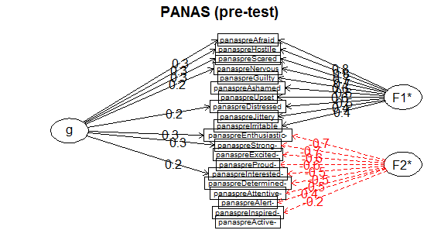
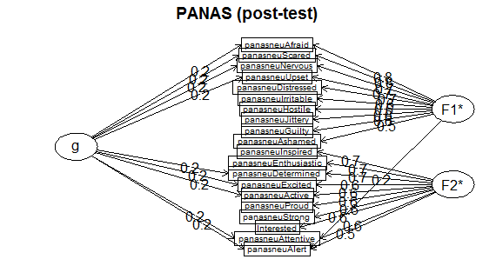
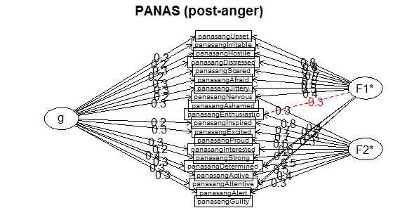
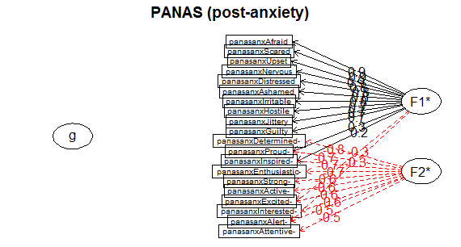
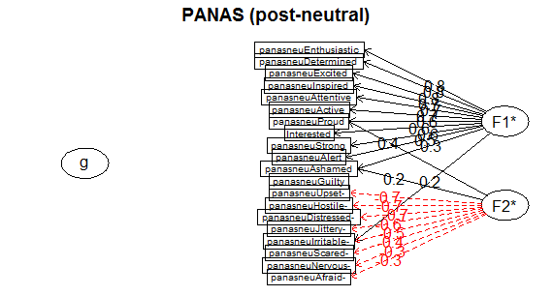
Psychometric Properties of the Positive and Negative Affect Schedule (PANAS) in a Think-Aloud Cognitive Assessment with an Experimentally-Induced Distraction
Wong, Chak, MA; Hsu, Kean, PhD; Kalina, Babeva, PhD; Feng, Michelle, PhD; Davison, Gerald, PhD
Abstract
Results
Conclusion
Hsu and Colleagues (2014) utilized the Articulated Thoughts in Simulated Situations (ATSS) think-aloud cognitive assessment paradigm to evaluate how distraction impacts cognitive and emotional processes under basic task performance, and found that cognitive but not emotional processes were compromised. Further verifying these initial findings, Classical Test Theory (CTT) was applied to assess the Positive and Negative Affect Schedule's (PANAS) psychometric properties, since the scale was measured before and after the distraction induction. Pre- and post-PANAS were not significantly different across the three distraction conditions, though post-anger and post-anxiety condition's diminished omega reliabilities suggests shifts in emotion. A better understanding of how distraction impacts the reliability and validity of assessments measuring affect holds important implications for future experimental and naturalistic studies employing affective assessment methods.
Reliability Two-Factor Model General-Factor Model
Pre- and Post-PANAS
In both conditions, the two-factor model had better fit than the general-factor model, but with a higher omega and lower icc in the pre-test in comparison to the post-test, one may infer this difference was influenced by the experimentally-induced feelings of anxiety and anger.
PANAS and emotions
Similar to the pre/post comparison, the two-factor model had better fit than the general-factor model. Interestingly, icc was higher in the anger and anxiety conditions compared to the neutral-emotion condition, suggesting intense emotions may drive participants’ responses.
As expected, pre-experiment PANAS values generally echoed results in the seminal study (Watson & Tellegen, 1988), and pre/post comparison generally supported initial findings (Hsu, Babeva, Feng, Hummer, & Davison, 2014). Interestingly, post-experiment PANAS values illustrated different patterns: Participants' emotional states in the neutral and anxiety conditions were comparable but differed from the anger condition. This suggests positive and negative emotions aren't mutually exclusive and can occur simultaneously, positive and negative emotions constitute anger, and anxiety could be devoid of positive emotions. Future studies could build on these results by incorporating latent class models or item response theory.
Condition | alpha | omega | ICC | x² | RMSEA | BIC | x² | RMSEA | BIC
Pre-test | .82 | .17 | .02 | x²=425.91, p<.05 | 0.15 | -263.88 | x²=852.11, p<.05 | 0.22 | 74.41
Post-test | .86 | .13 | .22 | x²=984.59, p<.05 | 0.14 | 127.92 | x²=2816.05, p<.05 | 0.24 | 1851.59
Post-anger | .77 | 0 | .25 | x²=365.15, p<.05 | 0.13 | -334.63 | x²=785.92, p<.05 | 0.2 | 8.22
Post-anxiety | .86 | .03 | .26 | x²=394.98, p<.05 | 0.14 | -295.8 | x²=1413469, p<.05 | 0.29 | 625.76
Post-neutral | .87 | .2 | .19 | x²=356.15, p<.05 | 0.13 | -334.63 | x²=785.92, p<.05 | 0.2 | 8.22
References
Introduction
Hsu and Colleagues (2014) utilized the Articulated Thoughts in Simulated Situations paradigm (ATSS; Davison et al., 1997) in a distraction study and found that cognitive but not emotional processes were compromised. The Positive and Negative Affect Schedule (PANAS; Watson & Tellegen, 1988) was selected for psychometric testing since it was measured before and after the experiment. While previous literature (Zevon & Tellegen, 1982; Clark & Watson, 1986; Watson, 1988) reported robust psychometric properties, and that the Positive Affect (PA) and Negative Affect (NA) factors accounted for 62.8% of the common variance and with a high convergent correlations rate (.89 to .95), these results weren’t tested in a distraction context, where threat to assessment validity is high.
Clark, L. A., Watson, D., & Leeka, J. (1989). Diurnal variation in the Positive Affects. Motivation and Emotion, 13(3), 205–234.
Davison, G. C., Vogel, R. S., & Coffman, S. G. (1997). Think-aloud approaches to cognitive assessment and the articulated thoughts in simulated situations paradigm. Journal of Consulting and Clinical Psychology, 65(6), 950–9 58.
Hsu, K. J., Babeva, K. N., Feng, M. C., Hummer, J. F., & Davison, G. C. (2014). Experimentally induced distraction impacts cognitive but not emotional processes in think-aloud cognitive assessment. Frontiers in Psychology, 5.
Watson, D. (1988). Intraindividual and interindividual analyses of positive and negative affect: Their relation to health complaints, perceived stress, and daily activities. Journal of Personality and Social Psychology, 54(6), 1020–1030.
Watson, D., Clark, L. A., & Tellegen, A. (1988). Development and validation of brief measures of positive and negative affect: the PANAS scales. Journal of Personality and Social Psychology, 54(6), 1063–1070.
Zevon, M. A., & Tellegen, A. (1982). The structure of mood change: An idiographic/nomothetic analysis. Journal of Personality and Social Psychology, 43(1), 111–122.
Method
Rstudio, and ‘CTT’ and ‘psych’ R packages were used to reanalyze Positive and Negative Affect Schedule results. PANAS measures taken before and after the experiment and of the three emotion conditions (control vs anger vs anxiety) were evaluated with alpha and omega correlation, internal consistency, and several goodness-of-fit indices. Pre- and post-PANAS results were compared to evaluate the assessment’s validity. PANAS results of the three emotion conditions were evaluated to understand if validity remained under different emotion conditions.

